Slide 1
Chapter 6
Chapters
1. Introduction
2. Graphs
3. Descriptive statistics
4. Basic probability
5. Discrete distributions
6. Continuous distributions
7. Central limit theorem
8. Estimation
9. Hypothesis testing
10. Two-sample tests
13. Linear regression
14. Multivariate regression
Continuous Probability Distributions

Slide 2
Review: Discrete vs. Continuous R.V.
Discrete R.V.
Takes on finite or countable infinite number of different values,
“Gaps” exist between values along the number line,
Possible to list all possible values with associated probabilities (Probability Distribution).
Continuous R.V.
Takes on ANY value in an interval,
No “gaps” between values,
Point probability P(X=x) = 0 for any x.

Slide 3
Point Probabilities are Zero
Because there is an infinite number of values, the probability of each individual value is virtually 0.
Thus, we can determine the probability of a range of values only.
E.g. with a discrete random variable like tossing a die, it is meaningful to talk about P(X=5), say.
In a continuous setting (e.g. with time as a random variable), the probability the random variable of interest, say task length, takes exactly 5 minutes is infinitesimally small, hence P(X=5) = 0.
It is meaningful to talk about P(X ≤ 5).

Slide 4
Probability Density Function…
Instead of P(x), continuous R.V. uses Probability Density Function (pdf)
The technical name of the curve,
Often represented as f(x)
f(x) ≥0 for all x (probabilities can’t be negative)
∫f(x)dx = 1 (The total area under the curve between a and b is 1.0
f(x)
area=1
a
b
x

Slide 5
Important Facts
For continuous distributions, P(X=a) = 0. Only the probability that X falls in an interval can be measured, and is measured as an area under the pdf curve.
Thus, P(a ≤X ≤b) is identical to P(a < X < b).
e.g. Exams scores have normal distribution (the most important continuous distribution) with mean 75 and standard deviation 5. What is the probability that an exam drawn at random will have a value of 85?
A 2.5% B. 5% C. 97.5% D. 0%
Some Discrete Variables we treat as continuous:
Any monetary figure like income, tax, etc. --dollar amounts are measured to the nearest penny, but are usually considered continuous.
Any time period like age, time record, etc, --could be more precise if measured with a smaller unit.

Slide 6
(II) Uniform Distribution

Slide 7


Uniform Distribution…
Consider the uniform probability distribution
It is described by the function:
f(x)
a
b
x
area = width x height = (b – a) x = 1

Slide 8
Example 1
The amount of gasoline sold daily at a service station is uniformly distributed with a minimum of 2,000 gallons and a maximum of 5,000 gallons.
Find the probability that daily sales will fall between 2,500 and 3,000 gallons.
What is the probability that the service station will sell at least 4,000 gallons?
What is the probability that the station will sell exactly 2,500 gallons?

Slide 9


Example 1
X ~ U[2000, 5000], so that the density function is:
Find the probability that daily sales will fall between 2,500 and 3,000 gallons.
P(2,500 ≤ X ≤ 3,000) = (3,000 – 2,500) x = .1667
What is the probability that the service station will sell at least 4,000 gallons?
P(X ≥ 4,000) = (5,000 – 4,000) x = .3333
f(x)
2,000
5,000
x

Slide 10

Example 1
What is the probability that the station will sell exactly 2,500 gallons?
P(X = 2,500) = (2,500 – 2,500) x = 0
“The probability that the gas station will sell exactly 2,500 gallons is zero”
f(x)
2,000
5,000
x

Slide 11
Expected value of uniform distribution
E[X] = (a + b)/ 2
V[X] = (1/12)(b – a)^2

Slide 12
(III) Normal Distribution

Slide 13
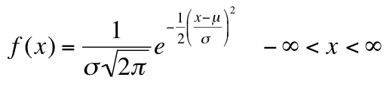
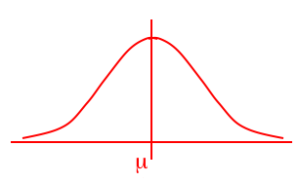
The Most Important Continuous Distribution
The normal distribution is fully defined by two parameters:
its standard deviation and mean
Unlike the range of the uniform distribution (a ≤ x ≤ b)
Normal distributions range from minus infinity to plus infinity
The normal distribution is bell shaped and symmetrical about the mean:
mean = median = mode = μ

Slide 14
Why is Normal important?
Data that are influenced by many small and unrelated random effects which are approximately normally distributed.
e.g. a student’s SAT score is the result of genetics, nutrition, illness, last night’s beer party, whether it was hard to find a parking spot the day the test was taken and cultural factors.
When you include ALL the factors, you get the Normal!
The Normal is Everywhere:
Stock market fluctuations
Natural Processes such as plant growth
Yearly temperature averages
Download times

Slide 15
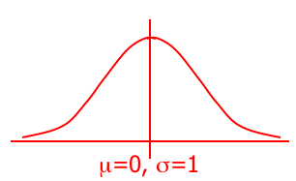
Standard Normal Distribution…
The Normal is a two parameter distribution (completely defined by the parameters μ and σ), represented with this notation:
X ~ N( μ, σ)
The Normal is an example of a distribution to which we can apply the Normal or Empirical Rule (Remember: 68%, 95%, and 99.7%)
A normal distribution whose mean is zero and standard deviation is one is called the standard normal distribution or Z distribution.
Z ~ N( 0, 1)
0
1
1

Slide 16


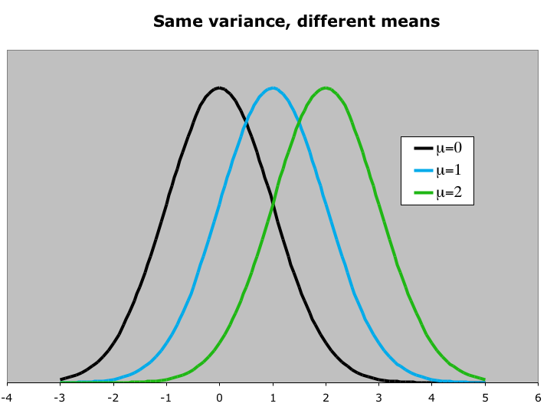
Normal Distribution…
The normal distribution is described by two parameters:
its mean and its standard deviation . Increasing the mean shifts the curve to the right…

Slide 17
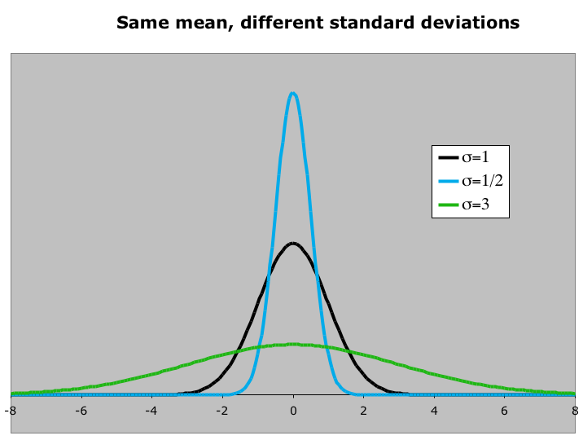
Normal Distribution…
The normal distribution is described by two parameters:
its mean and its standard deviation . Increasing the standard deviation “flattens” the curve…

Slide 18
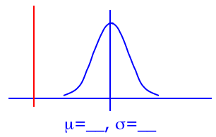
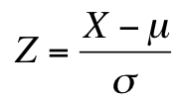
To Standardize Normal Distribution
We can use the following function to convert ANY normal random variable to a standard normal random variable Z.
This shifts the mean of X to zero…
X
0
Some advice: always draw a picture!
This changes the shape of the curve…
Z

Slide 19
Standardization
The values Z takes are called z-scores.
Z-score is literally the number of standard deviations the related X is from its mean.
For any normal distribution X it holds that:

Slide 20
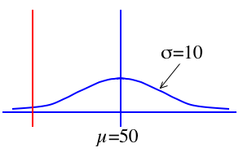
Calculating Normal Probabilities…
Example: The time required to build a computer is normally distributed with a mean of 50 minutes and a standard deviation of 10 minutes:
What is the probability that a computer is assembled in a time longer than 50 minutes?
P(50 < X) = P( 0 < Z ) = 0.5 (by symmetry)
0

Slide 21
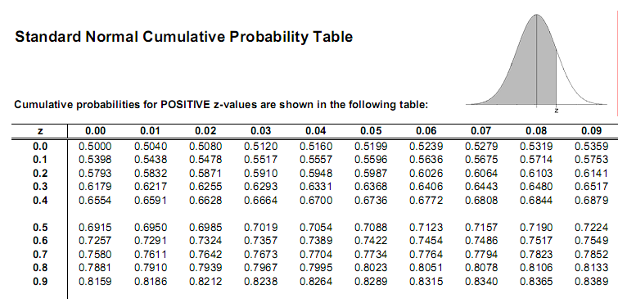
Example P(z ≤ 0.65)= 0.7422

Slide 22
Instead of using Table use Excel
The command is =norm.s.dist(z,1) and it calculates the probability to the left!!!
P(z<=0.65) = norm.S.dist(0.65,1)= 0.7422
P(Z<z) = 74.22%
Z
z=0.65

Slide 23
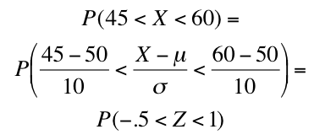
Calculating Normal Probabilities…
…mean of 50 minutes and a
standard deviation of 10 minutes…
P(45 < X < 60) ?
0

Slide 24
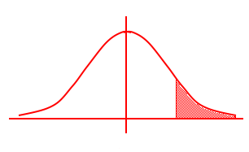
Using the Normal Table or Excel
What is P(Z > 1.6) ?
P(0 < Z < 1.6) = .4452
How about the rule of complements?
P(Z > 1.6)=1- P(Z ≤ 1.6)
z
0
1.6
P(Z > 1.6) = .5 – P(0 < Z < 1.6)
= .5 – .4452
= .0548

Slide 25
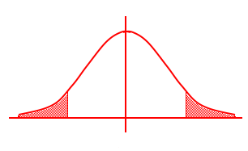
Using the Normal Table or Excel
What is P(Z < -2.23) ?
P(0 < Z < 2.23)
P(Z < -2.23)
P(Z > 2.23)
z
-2.23
0
2.23
P(Z < -2.23) = P(Z > 2.23)
= .5 – P(0 < Z < 2.23)
= .0129

Slide 26
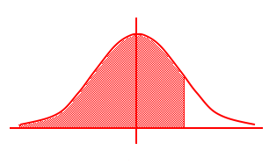
Using the Normal Table or Excel
What is P(Z < 1.52) ?
P(Z < 0) = .5
P(0 < Z < 1.52)
z
0
1.52
P(Z < 1.52) = .5 + P(0 < Z < 1.52)
= .5 + .4357
= .9357

Slide 27
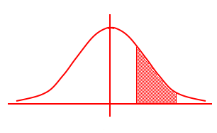
Using the Normal Table or Excel
What is P(0.9 < Z < 1.9) ?
P(Z < 0.9)
P(Z < 1.9)
z
0
0.9
1.9
P(0.9 < Z < 1.9) = P(Z < 1.9) – P(Z < 0.9)
=.9713 – .8159
= .1554

Slide 28
Example 1
The return on investment is normally distributed with a mean of 10% and a standard deviation of 5%. What is the probability of losing money?

Slide 29
Example
We want to determine P(X < 0). Thus,
Using Excel: =NORM.S.DIST(-2,1)

Slide 30
Example 2
If the standard deviation is 10, the probability of losing money is? P(X < 0)

Slide 31
Example 2
The probability of losing money is: P(X < 0)
Or in Excel: =NORM.S.DIST(-1,1)
Thus, increasing the standard deviation increases the probability of losing money, which is why the standard deviation (or the variance) is a measure of risk.

Slide 32

Finding Values of z
Often we’re asked to find some value of z for a given probability, i.e. given an area ($π$) under the curve, what is the corresponding value of z on the horizontal axis that gives us this area?
That is, find z so that $P(Z<z)=π$, where $π$ is given!
In other words, find the -th percentile in the standard normal distribution: z=norm.S.inv()
P(Z<z)= 
z= norm.S.inv()

Slide 33
Calculating Normal Probabilities…
Lifetimes of light bulbs that are advertised to last 5000 hours are normally distributed with μ=5100, σ=200.
What is the probability that a bulb lasts longer than advertised?
What figure should be advertised if the company wishes to be sure that 98% of all bulbs last longer than the advertised figure?
What is the upper and lower limit of the inter-quartile range?
Between what two lifetimes does the middle 95% light bulbs lie?

Slide 34
Answers
P(X>5000)=1-NORM.S.DIST((5000-5100)/200,1) = 0.6915
P(X>x_A)=0.98, or P(X<x_A)=0.02, so that =NORM.S.INV(0.02)*200+5100 = 4689.25
X_75%-X_25% is interquartile range: P(X<x_25%)=0.25, or =NORM.S.INV(0.25)*200+5100= 4965.10205 P(X<x_75%)=0.75, or =NORM.S.INV(0.75)*200+5100= 5234.89795
P(x_a<X<x_b)=0.95, or P(x_a<X)=0.025, or =NORM.S.INV(0.025)*200+5100= 4708.007203 P(x_b<X)=0.975, or =NORM.S.INV(0.975)*200+5100= 5491.992797

Slide 35
Optional: The Binomial-Normal Connection
Recall that when n is large, the binomial graph comes to resemble a normal curve.
When is the “Normal Approximation” good enough? That is, how large should n be?
Need TWO conditions:
n*π >= 5 and
n*(1-π ) >= 5.
In the past, computing the Normal required less time and resources. So it’s convenient to approximate the Binomial (and many other discrete distributions) with the Normal.

Slide 36
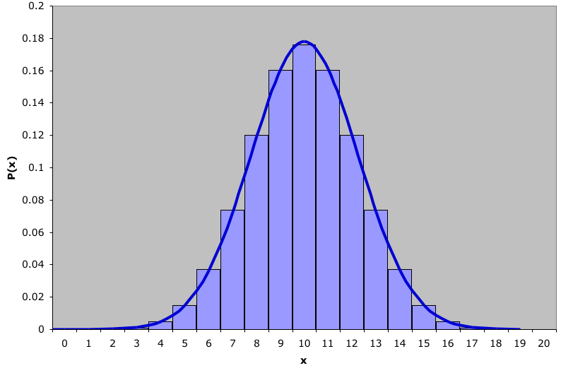
Normal Approximation to Binomial…
Binomial distribution with n=20 and p=0.5 with a normal approximation superimposed ( =10 and =2.24)

Slide 37
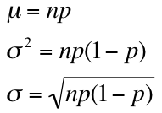


Normal Approximation to Binomial…
Binomial distribution with n=20 and p=.5 with a normal approximation superimposed ( =10 and =2.24)
where did these values come from?!
From §7.6 we saw that:
Hence:
and

Slide 38
Normal Approximation to Binomial…
To calculate P(X=10) using the normal distribution, we can find the area under the normal curve between 9.5 & 10.5.
The 0.5 is called “continuity correction factor.”
The !!!general!!! rule for the continuity correction factor is
P(a≤X≤b) ≈ P(a-½ < Y < b+½)
Is there ever a case when correction factor is not needed? See your textbook P293.
P(X = 10) ≈ P(9.5 < Y < 10.5)= .1742
In fact: P(X = 10) = .176
the approximation is quite good.
where Y is a normal random variable approximating
the binomial random variable X

Slide 39
(IV) Student’s T Distribution

Slide 40
Another Important Continuous Distribution: Student’s t
An approximation of the Standard Normal.
We use it when we don’t know σ but we do know the population is normally distributed.
We substitute s (sample standard deviation) for σ in our standardization formula and get the t.
It looks like the Standard Normal, but it varies with n, the sample size. We call v=n-1 “the degree of freedom.”

Slide 41
When do we use the T-distribution?
Sigma is known: Normal
Sigma is unknown: T

Slide 42
Student’s t
t is flatter than a Normal because of the uncertainty added by using sample standard deviation s.
t has “fat tails”.
As n increases, the t approaches the Standard Normal.

Slide 43
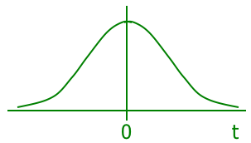

Student t Distribution
Much like the standard normal distribution, the Student t distribution is “bell” shaped and symmetrical about its mean of zero:
The mean and variance of a Student t random variable are:
E(t) = 0 and
V(t) = for > 2, where v=n-1.

Slide 44
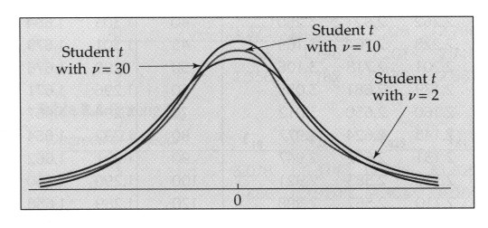
Student t Distribution…
In much the same way that and define the normal distribution, , the degrees of freedom, defines the Student t Distribution:
As the number of degrees of freedom increases, the t distribution approaches the standard normal distribution.

Slide 45
Degrees of Freedom
Please perform the following steps.
Select 4 numbers at random.
Now, select a fifth number so that the mean of all five numbers equals 10.
Is your five number sample a “random” sample?
How much, if any, of it is?
What are “degrees of freedom”?

Slide 46
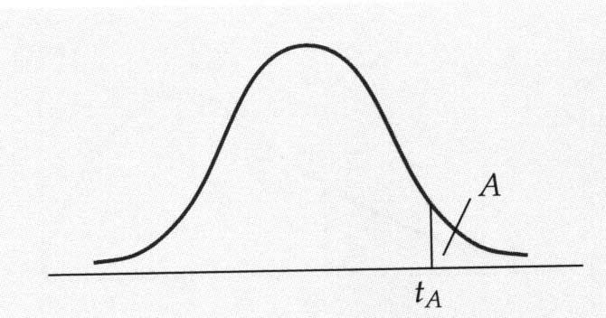

Determining Student t Values…
The student t distribution is used extensively in statistical inference.
That is, values of a Student t random variable with degrees of freedom such that:
The values for A are pre-determined “critical” values, typically in the 10%, 5%, 2.5%, 1% and 0.5% range.

Slide 47
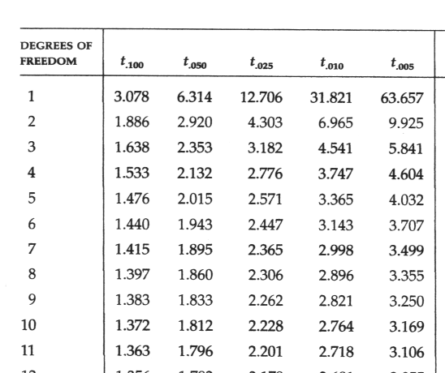
Using the t table for values…
For example, if we want the value of t with 10 degrees of freedom such that the area under the Student t curve is .05:
Area under the curve value (t_{A}) : COLUMN
t_{.05,10}
t_{.05,10}=1.812
Degrees of Freedom : ROW

Slide 48
Using Excel
P(T<t)=T.DIST(t,df,1)
P(T<t)

Slide 49
Using Excel
To get the positive t value that has the specified probability to the left: t=T.INV(,df)
Calculate 5th percentile (, i.e. =0.05) with d.o.f.=50
5%
t=T.INV(0.05, 50) = - 1.67591

Slide 50
An Example
A sample of 25 Econ205 students revealed that they studied on average 5 hours a week with a standard deviation of 2.46. In addition you know that study time follows a normal distribution centered around 5 hours.
What is the probability that a student studied more than 7.5 hours?

Slide 51
Answer:
P(X>7.5)=?
If we knew σ, we could use Standard Normal:
P(Z>(7.5-mu)/ σ)=P(Z>2.5/ σ), however we don’t know the σ, so we use t-Distribution
P(T> (7.5-xbar)/ s)= P(T>2.5/ 2.46) = P(T>1.016) or =1-T.DIST(1.016,25-1,1)= 0.1599

Slide 52
Transformation Formulas

